Slide 1
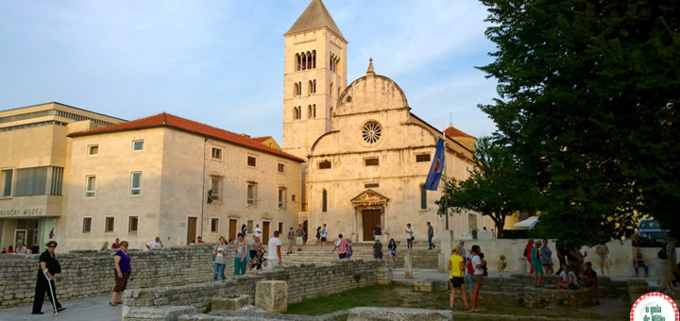
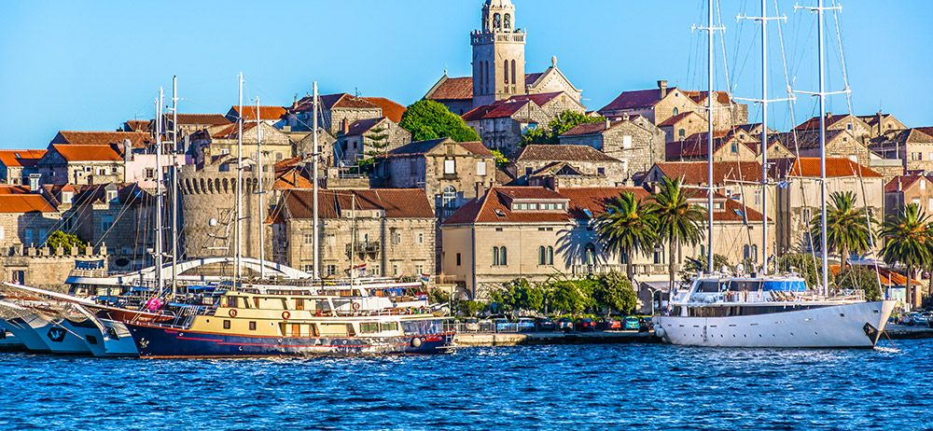
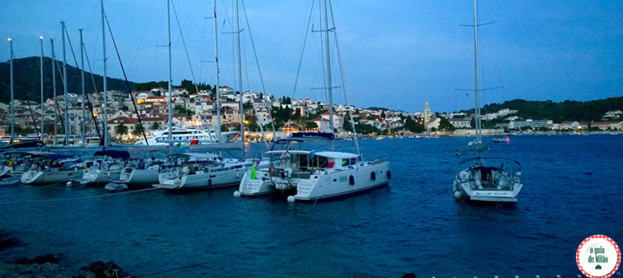




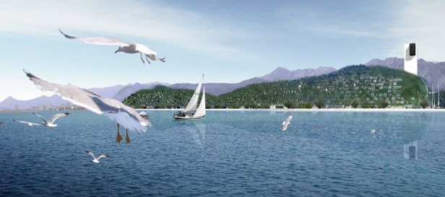
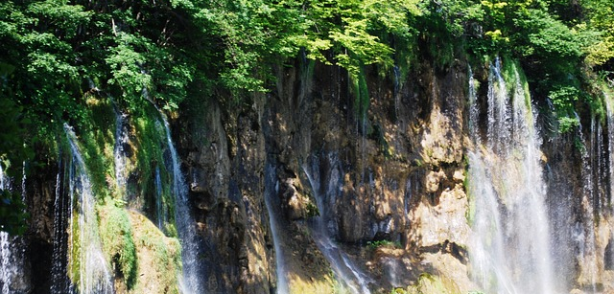
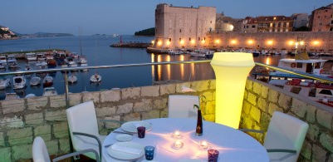
Chamber of Commerce, Studies and Business Brazil - Croatia

Slide 2
Who are we?
The Brazil-Croatia Chamber of Commerce (BRACRO) is a non-profit organization with the aim of promoting business exchange and relationships in various segments between the two countries.

Slide 3
History
BRACRO, initially created as a study and business group in 2020, is made up of professionals, Croatians and descendants, with different experiences and knowledge.

Slide 4
Main Goals
Complement the activities of existing associations, bringing a focus on business.
Boost trade, investment and academic-technological exchange relations between Brazil and Croatia.
Study the socioeconomic reality of the two countries and promote this knowledge.
Support entrepreneurs from both countries.

Slide 5
Activities
Targeted business prospecting.
Connect Brazilian professionals of Croatian origin through events or platforms.
Hold events of various natures with the aim of promoting economic relations.

Slide 6
Activities
Prepare annual reports with information on the economic scenario and trends.
Carry out individual research on companies, brands, with personalized consultancy.
Work on defining and promoting the Croatia brand in Brazil.
Maintain contact with institutions that promote Croatia.

Slide 7
Main Events Held
Course “Digital Nomad in Croatia”
Course “From grape to the glass of wine” (hybrid).
You heading to Croatia (online).
Competitive Intelligence
You Head to Croatia (for Tourism Professionals)
Brazilian Week in Pula

Slide 8
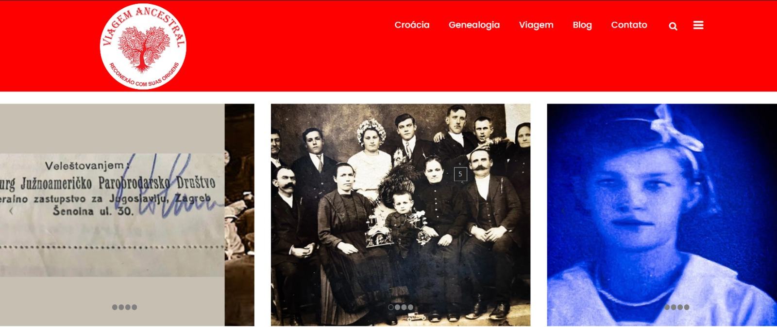
On going Projects
Project Ancestral Trip: Platform online with information about tourism and genealogy

Slide 9
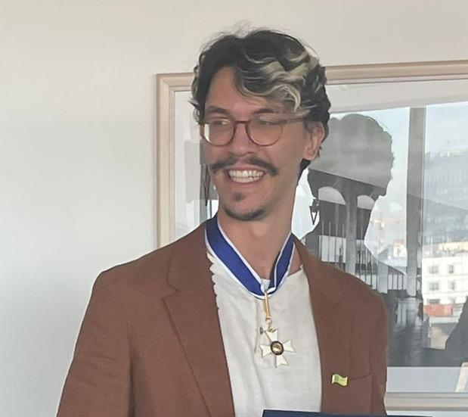
On going Projects
Course of Portuguese directed for Tourist Guides and other Workers in Tourism

Slide 10
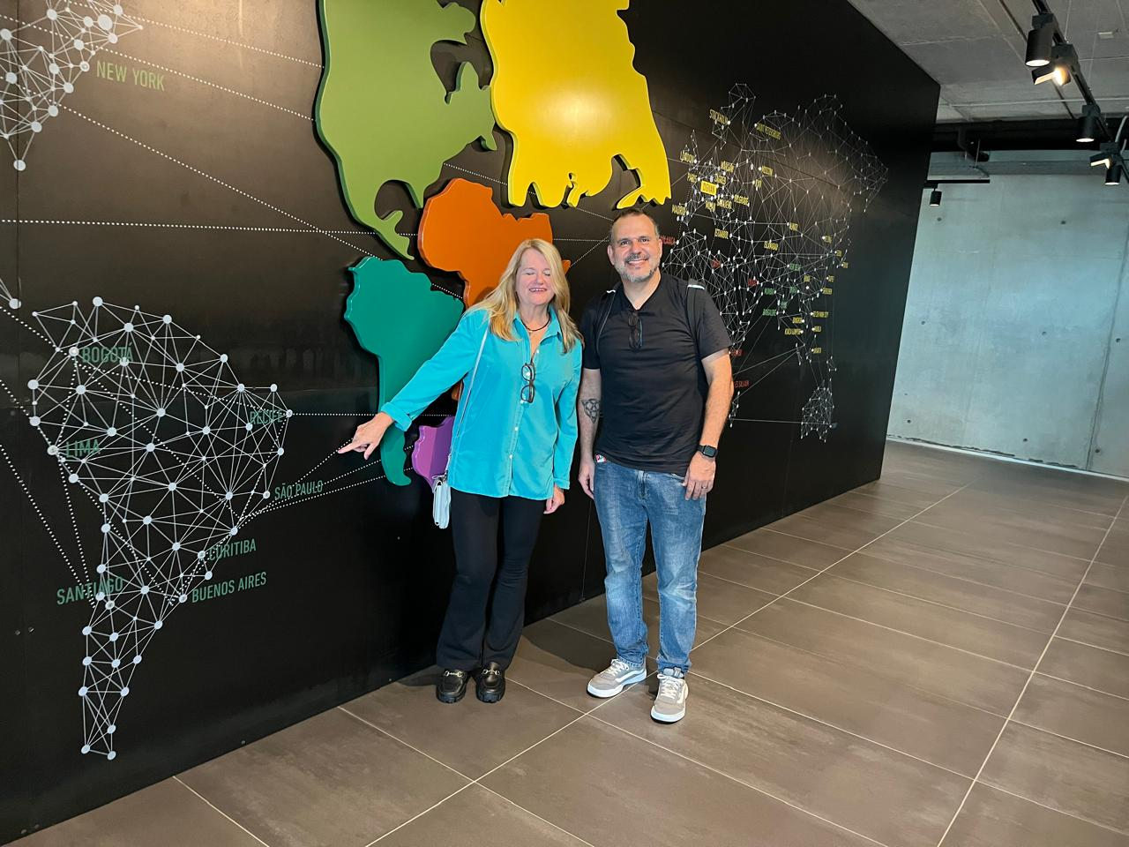
On going Projects
Project Startup: Croatia Connection - Call for Proposals for a Brazilian Startup Integration Project Focused on Croatia.

Slide 11
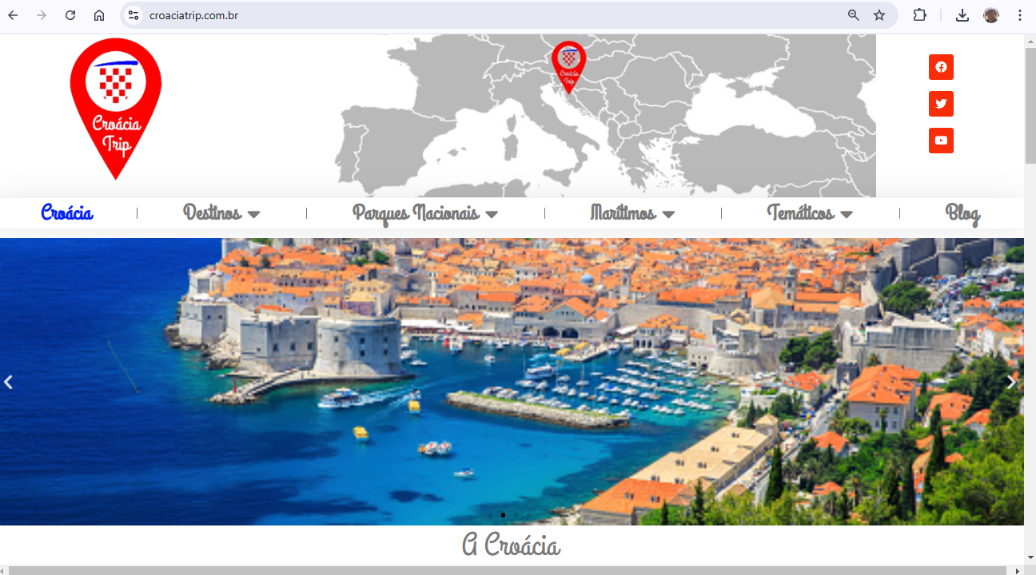
On going Projects
Plataforma de Turismo: croaciatrip.com.br

Slide 12
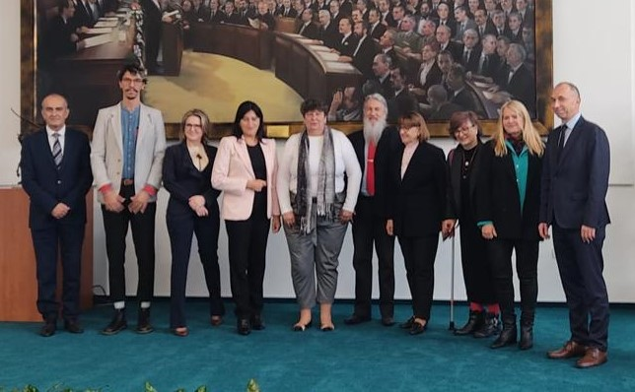
Mission BRACRO in Croatia - 2024
Visit to the new Technologycal Park in Split
Meeting with State Secretary concerning Croats descendentes in Brazil
Meeting with Croatian Chamber of Commerce
Received in the Parliament by Mrs. Zdravka Bušić and other members of Parliament
Meeting with Croatian Board of Tourism
Visit and meeting to Croatian Companies and shows

Slide 13
Formalization
President – Solange Benites Juvella
Vice President – Sonia Kohler Garcia
Secretary: Paula Pexider Srica Winger
Treasurer – Igor Hitner da Silva
Substitute – Marcia Radaic Ladeira de Araujo
1st Counselor: Milan Puh
2nd Counselor: Adilson de Almeida Lima
3rd Counselor: Teresa Ana Buneta
Substitute: Bernardo Garbui Csuraji Fernandes

Slide 14


HVALA SVIMA

